Slide 1
CUSTOMER SEGMENTATION VIA CLUSTERING

Slide 2
Intro and problem statement
Customer segmentation is the practice of dividing a company’s customers into groups that reflect similarity among customers in each group.
The goal of segmenting customers is to decide how to relate to customers in each segment in order to maximize the value of each customer to the business.
Customer segmentation has the potential to allow marketers to address each customer in the most effective way.
One approach to customer segmentation is leveraging machine learning algorithms to discover new segments.

Slide 3
Datasets
The datasets are provided by Olist, which is a Brazilian E-Commerce company
The dataset has information of 100k orders from 2016 to 2018 made at multiple marketplaces in Brazil. Its features allows viewing an order from multiple dimensions: from order status, price, payment and freight performance to customer location, product attributes and finally reviews written by customers.

Slide 4

DATA SCHEMA

Slide 5
Exploratory data analysis
The product and orders datasets have NaNs in them. While the other datasets(customers, items, payments, sellers and categories) don’t
A total of 3K sellers are serving the 95K customers present in the dataset
98K orders were placed to purchase 33K different products

Slide 6
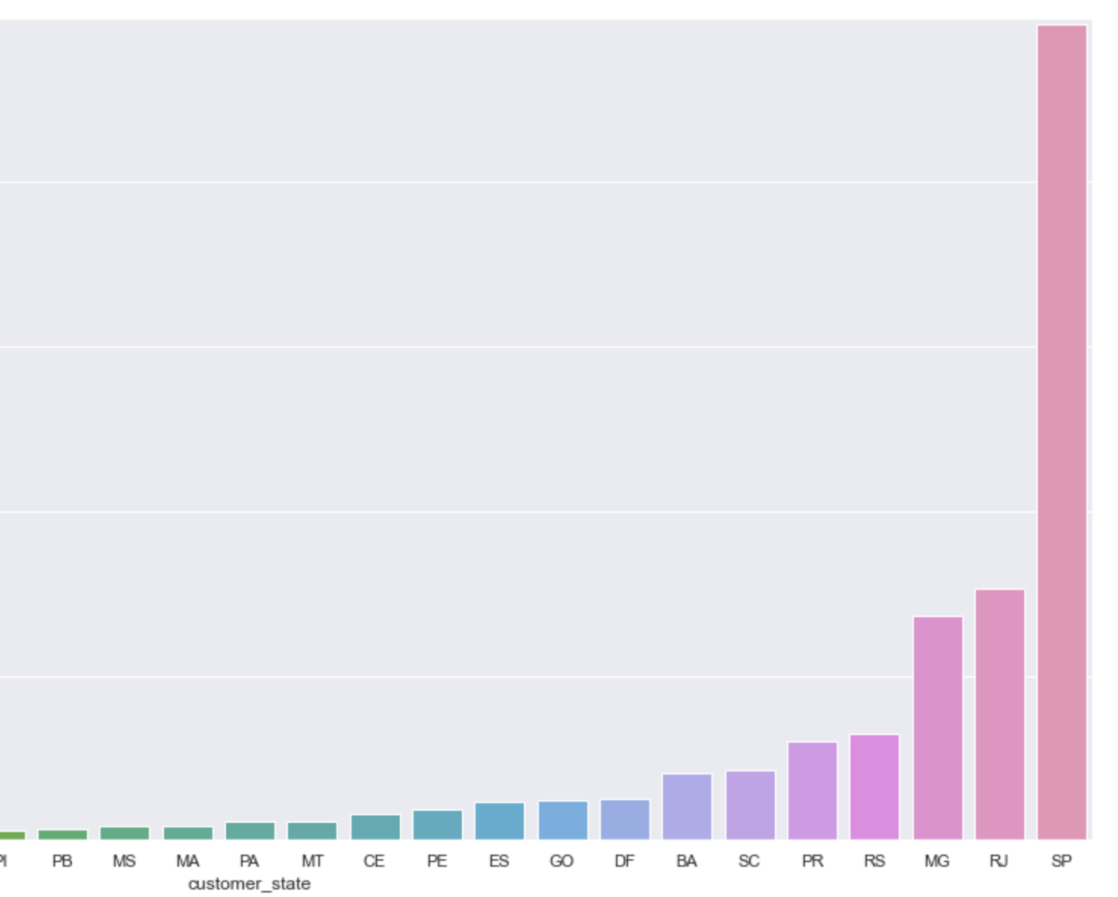
Exploratory data analysis (CONTD)
Majority of the customers are from Sao Paulo state
While very few from Roraima state

Slide 7
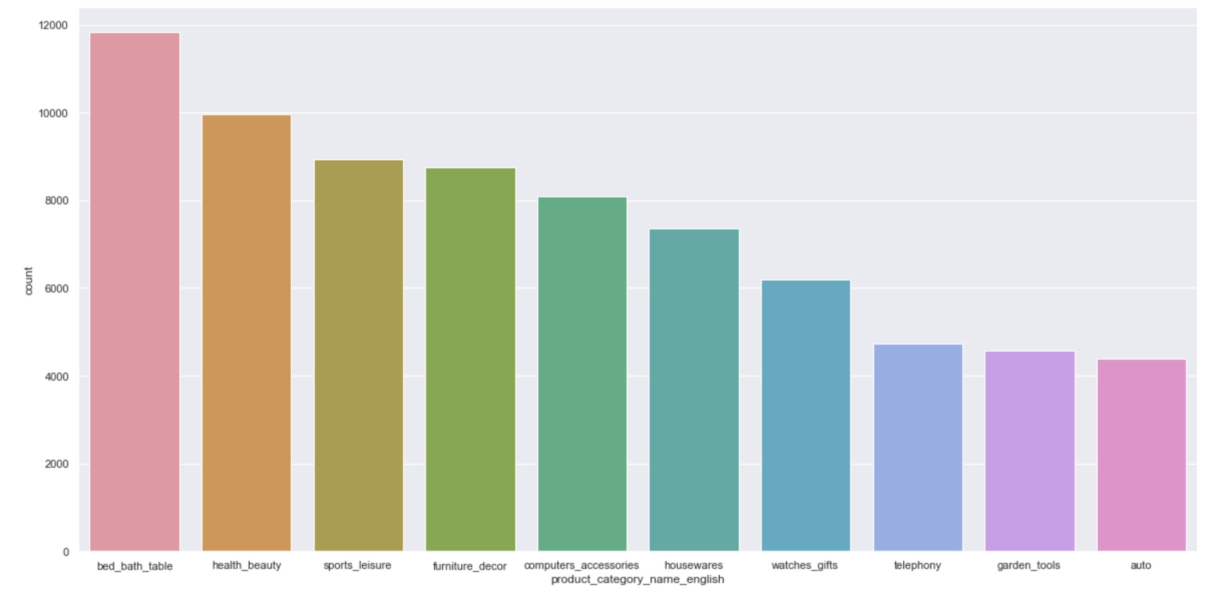
Exploratory data analysis (CONTD)
Most of the orders were placed from the bed & bath category
While very few orders were from Automobiles

Slide 8
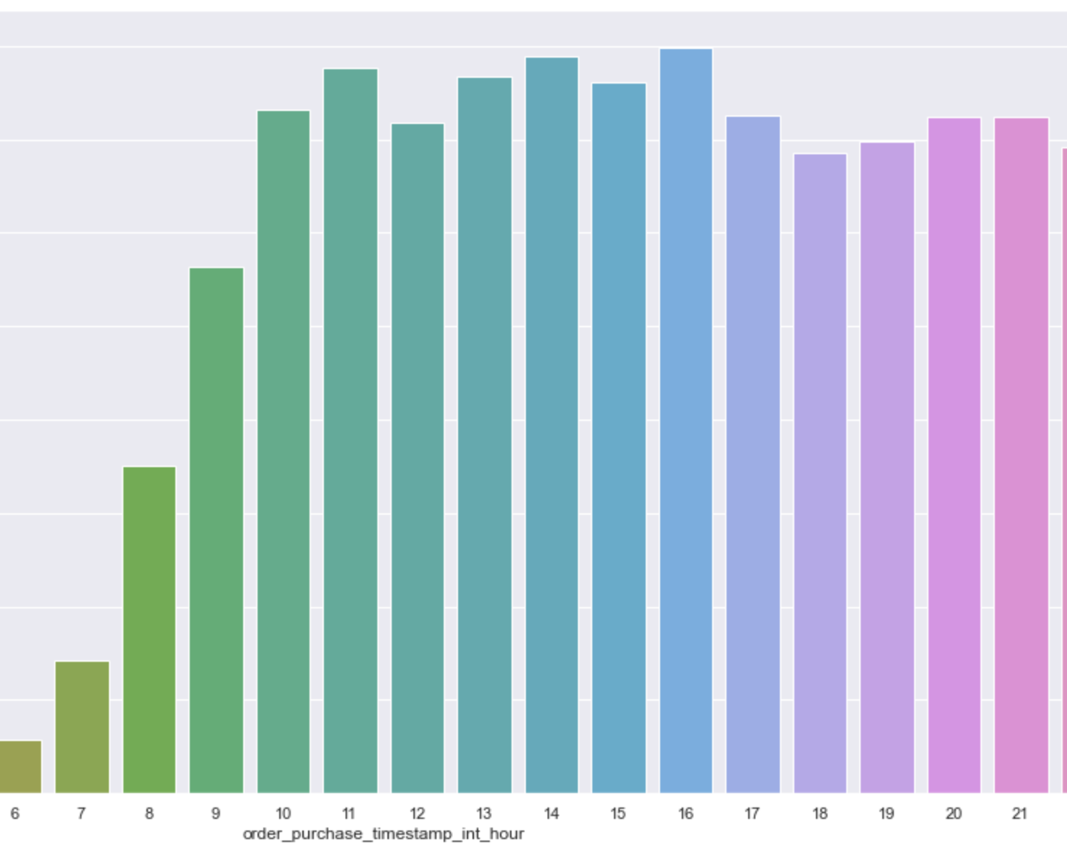
Exploratory data analysis (CONTD)
Most of the orders are placed stating from 8 AM till 11 PM. While 4 PM being the most active hour

Slide 9
Insights Summary
Below are some of the important insights from the dataset.
A lot of the customers and sellers live and operate around Sao Paulo region. Followed by Rio de Janerio
Bed and bath category occupied most of the orders followed by cosmetics
Most of the orders were placed from 8 AM till 11 PM
There are a total of 3K sellers present for 95K customers present

Slide 10
DATA PREPROCESSING
The customers, items, payments, sellers and categories datasets are merged
The rows with NaNs are dropped from the dataset
Timestamp columns i.e.,‘order_approved_at','order_delivered_carrier_date','order_delivered_customer_date','order_estimated_delivery_date','shipping_limit_date’ are split into year, month, day, hour, is_weekday or is_weekend
Customer_city and seller_city columns are dropped since the dimensionality will increase

Slide 11
DATA PREPROCESSING(CONTD)
Numerical columns are standardized
Categorical columns are one-hot encoded and merged with standardized numerical columns

Slide 12
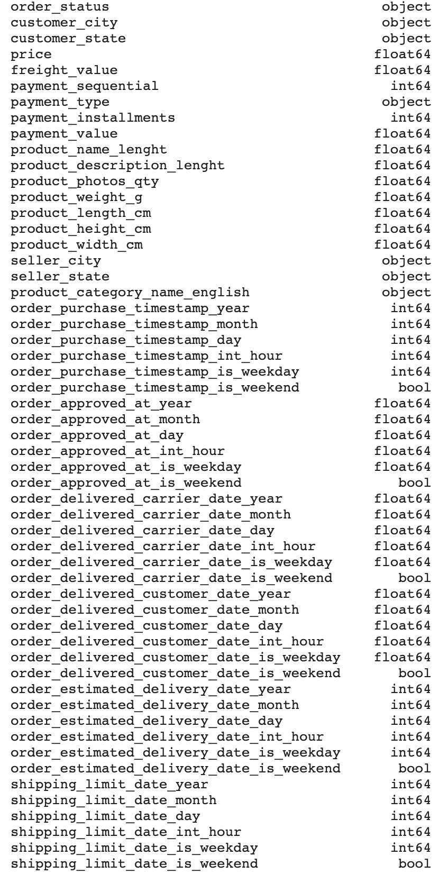
FEATURES

Slide 13
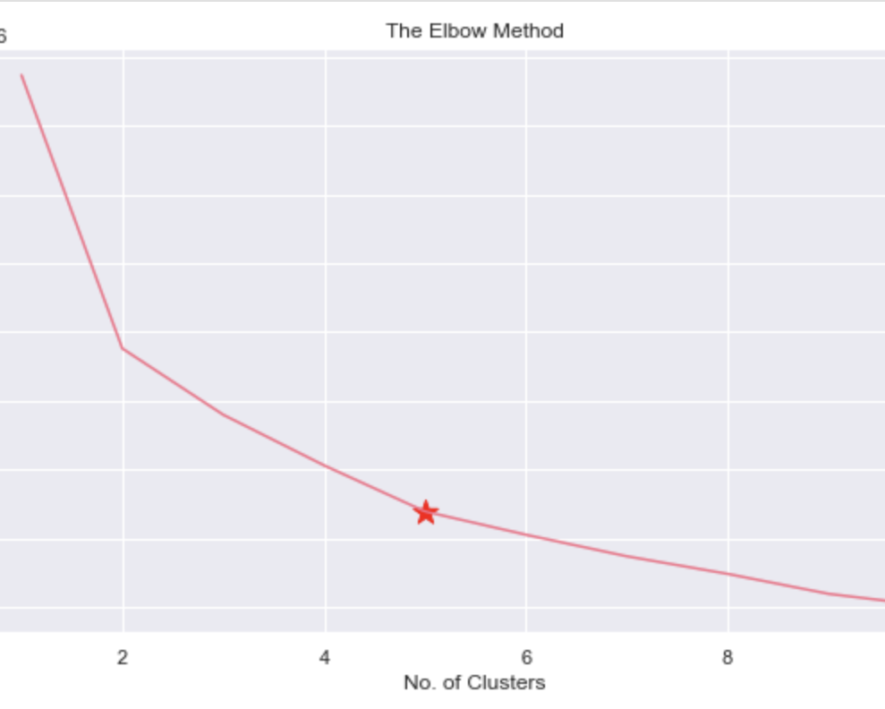
K-MEANS
After the data was one-hot encoded and scaled, K-Means clustering algorithm was applied and the optimal number of clusters were found to be 5 based on the elbow method
So, based on these 5 clusters, appropriate treatment could be designed. Like personalizing marketing campaigns etc.

Slide 14
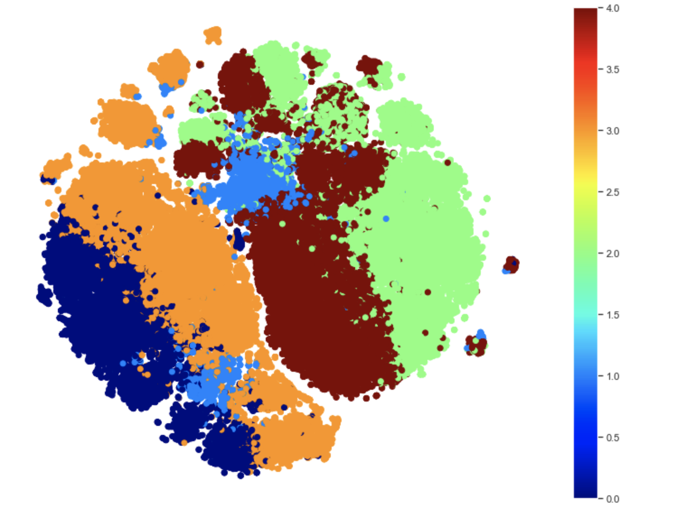
K-Means(CONTD)
Based on the t-SNE visualization, we see the clusters in higher dimensions
t-SNE is a statistical method for visualizing high-dimensional data by giving each datapoint a location in a two or three-dimensional map

Slide 15
PCA
In order to reduce the dimensionality of the dataset, PCA was applied to reduce the components to 3
PCA ensures that noise is suppressed and speeds up computation of pairwise distances between the samples

Slide 16
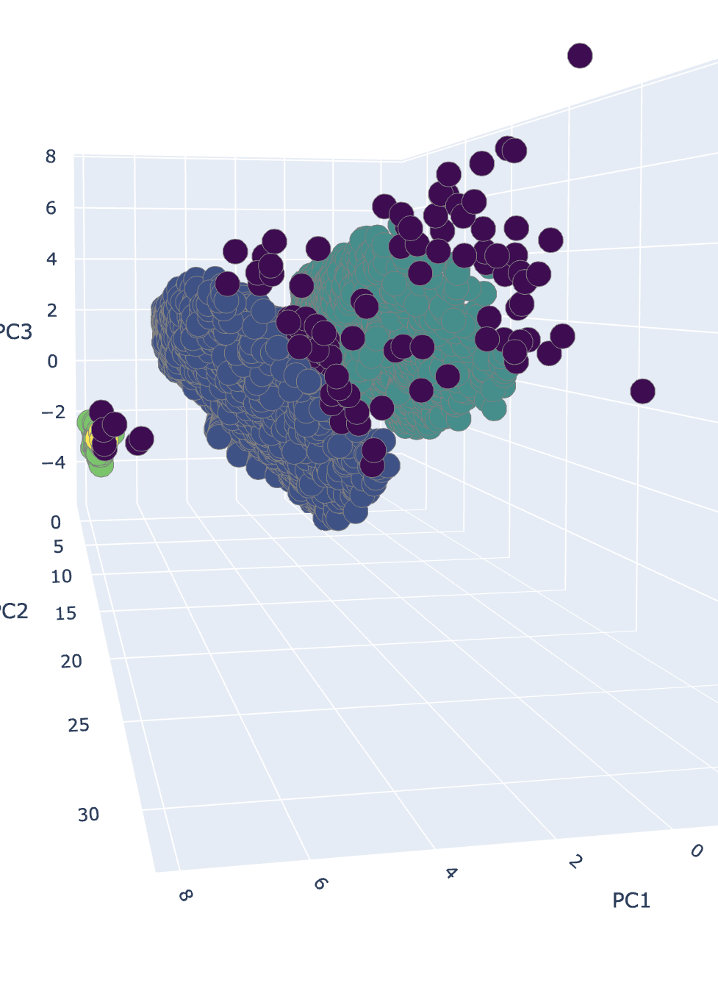
DBSCAN
DBScan clustering algorithm was applied after PCA with epsilon value of 1 and 9 as minimum number of samples
The silhouette coefficient is 0.457 with 117 records classified as noise
A total of 4 clusters were created based on which treatments could be designed to maximize business value

Slide 17
Performance Evaluation
The metric to evaluate both the clustering methods is through Silhouette score
The score relates to a model with better defined clusters. It is bounded between -1 for incorrect clustering and +1 for highly dense clustering
The Silhouette score for K-Means is found to be 0.102, while the score for DBSCAN is 0.457
We can see that clustering performance of DBSCAN is better as compared to K-Means

Slide 18
CONCLUSION
Customer Segmentation is used to group customers based on similarity. The goal behind is to increase business value of each customer
The dataset used is from a Brazilian E-Commerce company, containing details regarding customers, sellers, orders, products etc
Preprocessing steps like splitting timestamps, scaling and one-hot encoding are carried out
Clustering algorithms like K-Means and DBScan are explored and implemented

